Slide 1
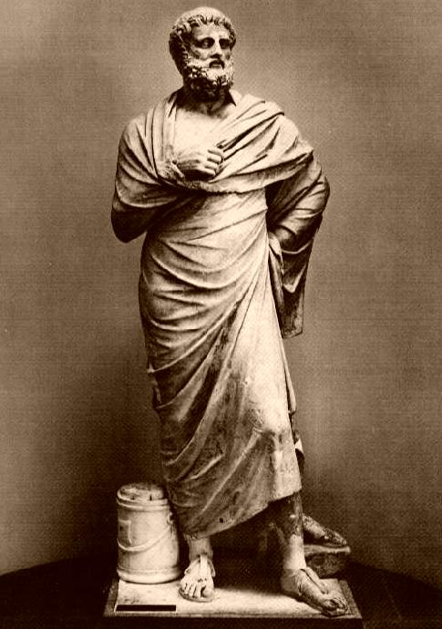
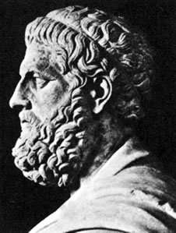
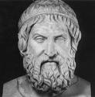
Background on Greek Drama and Antigone by Sophocles

Slide 2
Sophocles and Greek Drama
How was Greek drama born?
It developed from ancient rituals honoring Dionysus (The god of Wine and Fertility). The celebrations became a yearly occurrence held in Athens.
Stage performances/contests

Slide 3
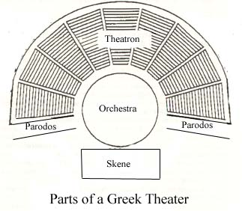
Sophocles and Greek Drama
Describe the theater of Dionysus.
Semicircle
Seats carved out of stone on a hillside
15,000-16,000 spectators
Political in nature

Slide 4
Sophocles and Greek Drama
Sophocles surprised Athenians by:
Winning first prize for tragedy at the festival of Dionysus, beating Aeschylus.
Who was Aeschylus?
The leading playwright of the time (think Steven Speilberg)
How many tragedies did Sophocles write?
He wrote more than 120 tragedies… only 7 still survive today.

Slide 5
Sophocles and Greek Drama
What was Sophocles concerned about?
He was concerned with the individual’s need to find his/her place in the world within the existing moral/cosmic order.
Moral lessons against too much pride and religious indifference.
What did Sophocles add to Greek drama?
A third actor (originally two- used masks)
Painted sets
Larger chorus (from 12 to 15 members)

Slide 6
Greek Chorus
Greek Tragedy was almost wholly lyrical
Made up of background characters (Bystanders)
Town Elders
Young Maidens
Captives of War
Asked questions, commented on actions, offered approval or criticism, gave advice

Slide 7
Greek Chorus
Purpose:
Set the mood
Add beauty
Provide background information
Divide the action into episodes
Reflect on events and themes

Slide 8
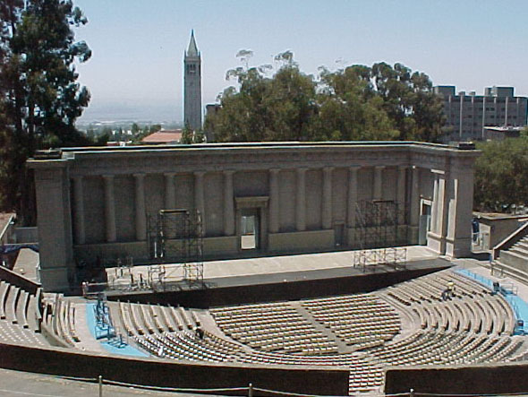
Greek Theatre

Slide 9
Greek Dramatic Structure
THE PROLOGUE (PROLOGOS): THE OPENING PORTION OF THE PLAY, WHICH SETS THE SCENE AND CONTAINS THE EXPOSITION OR BASIC SITUATION.
THE PARADOS: THE ENTRANCE SONG OF THE CHORUS. THE PARADOS IS NAMED AFTER THE BROAD AISLE ON EITHER SIDE OF THE THEATER, WHERE THE CHORUS ENTERED OR EXITED.

Slide 10
Greek Dramatic Structure
THE EPISODES (SCENES): SCENE IN THE ACTION OF THE DRAMA... THE EPISODES ALTERNATE WITH THE STASIMONS (ODES).
THE STASIMONS (ODES): A CHORAL PASSAGE, ALTERNATING WITH THE EPISODES OF THE PLOT OF THE DRAMA. AN ODE IS A TYPE OF LYRIC POEM. THE TRAGIC ODE CONSISTS OF STROPHES (CHANTS) AND ANTISTROPHES (RESPONSES) IN STANZAS OF THE POEMS. THIRD PART OF THE ODE IS THE EPODE.

Slide 11
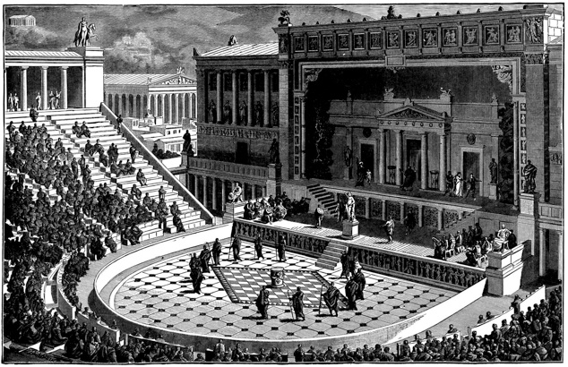
Greek Dramatic Structure
EXODUS: THE CONCLUDING SECTION OF THE TRAGEDY. THE EXODUS ENDS WITH THE CHORUS SINGING THEIR FINAL LINES AS THEY EXIT.

Slide 12
Greek Dramatic Structure
A CLASSIC GREEK TRAGEDY CONSISTS OF:
PROLOGUE
PARADOS
SCENE 1 (EPISODE 1)- action
ODE 1 (STASIMON 1)- chorus
SCENE 2 (EPISODE 2) - action
ODE 2 (STASIMON 2) - chorus
SCENE 3 (EPISODE 3) - action
ODE 3 (STASIMON 3) - chorus
SCENE 4 (EPISODE 4) - action
ODE 4 (STASIMON 4) - chorus
EXODUS

Slide 13
Common in Greek Tragedy:
Dramatic irony: When the audience knows something that the characters don’t know
Fall of Hubris: Hubris is excessive pride. Many tragedies deal with human pride leading to arrogant behaviors that anger the gods. Thus, man must be punished.
Fate vs. Destiny: Many tragedies feature characters who try to escape unfavorable prophecies. This is futile, however, as man does not often have the power or luck to change his/her fate as determined by cosmic forces or gods/goddesses.

Slide 14
Characteristics of a Tragic Hero
Must have a fall from greatness (either power, wealth, or social standing)
Must be an extraordinary person, yet have a tragic flaw
Tragic flaw: often a positive character trait that, when taken to the extreme, causes tragedy
Must experience a moment of realization that he/she has erred
Must suffer greatly due to his/her actions or flaw (often, but not always, this means death)

